Slide 1
Bank Loan Financial Analytics
Executive Portfolio Analysis & Risk Insights

Slide 2
GROUP MEMBERS
J. Nikitha
N. Sinchana
K. Mahendra
kishore kumar
B. Veeranjaneyulu
E. Jyothi
K. R. Sumanth Reddy

Slide 3
Project overview
  This project focuses on analyzing bank loan data to understand loan distribution, customer credit characteristics, repayment behavior, loan status, and payment patterns.
Two Excel datasets were used.
Both datasets contain approximately 39K+ records.
The datasets were combined using the common id column.
Excel, MySQL, Tableau, and Power BI were used for analysis and visualization.

Slide 4
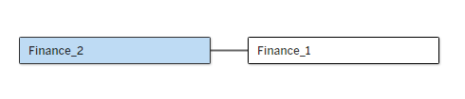
DATA SET & data SOURCES
Finance_1.xlsx
→ Loan/Application & Customer Information
Finance_2.xlsx
→ Credit History & Payment Information
Common Key: id
Finance_1 + Finance_2 → Combined Bank Loan Dataset

Slide 5
Workflow Followed
DATA LOADING
DATA CLEANING
DATA INTEGRATION
DATA MODELING
INSIGHTS
DASHBOARD
VISUALIZATION
ANALYSIS

Slide 6
Project Objectives
The project focused on five major analyses:
1. Year-wise Loan Amount Statistics
Analyze how loan amounts changed over different years.
2. Grade & Sub-grade-wise Revolving Balance
Analyze revolving balances across borrower grades and sub-grades.
3. Total Payment by Verification Status
Compare payments across verified and non-verified borrower categories.
4. State-wise & Month-wise Loan Status
Understand the distribution of loan status across states and time.
5. Home Ownership vs Last Payment Date
Analyze payment trends across different home ownership categories.

Slide 7
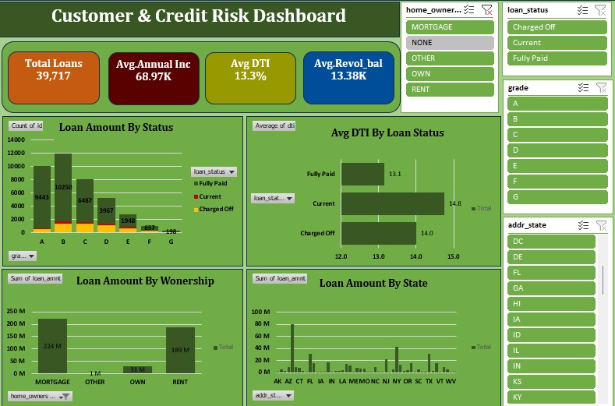
excel Dashboard :

Slide 8
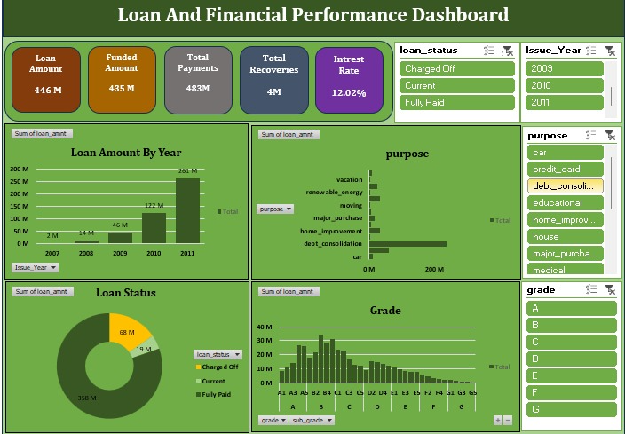
Dashboard-2

Slide 9
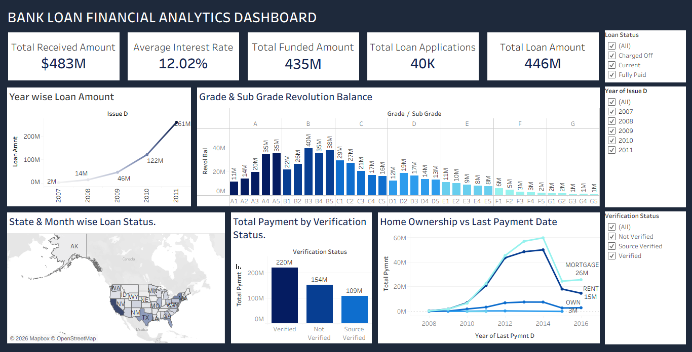
Tableau Dashboard :

Slide 10
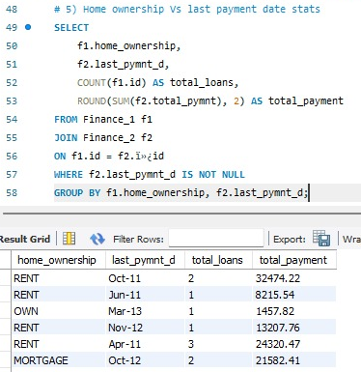
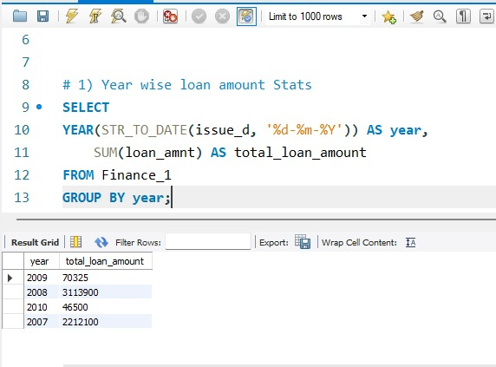
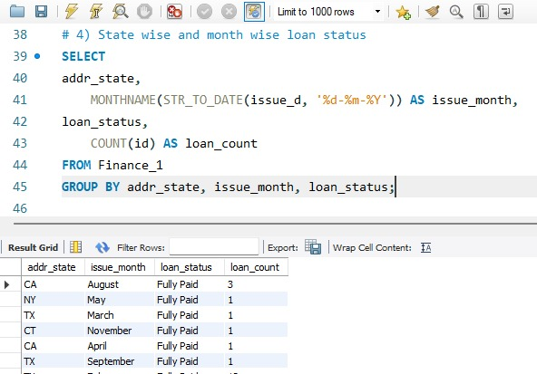
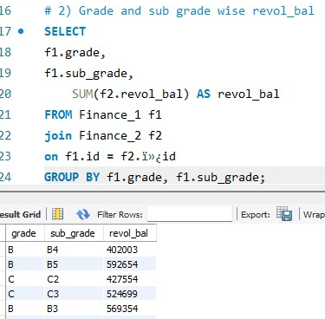
MySQL Analysis :
MySQL was used to perform:
Data querying and filtering
Aggregation using SUM, COUNT, and AVG
GROUP BY analysis
ORDER BY analysis
Joining datasets using id
Year, month, state, grade, and verification-based analysis

Slide 11
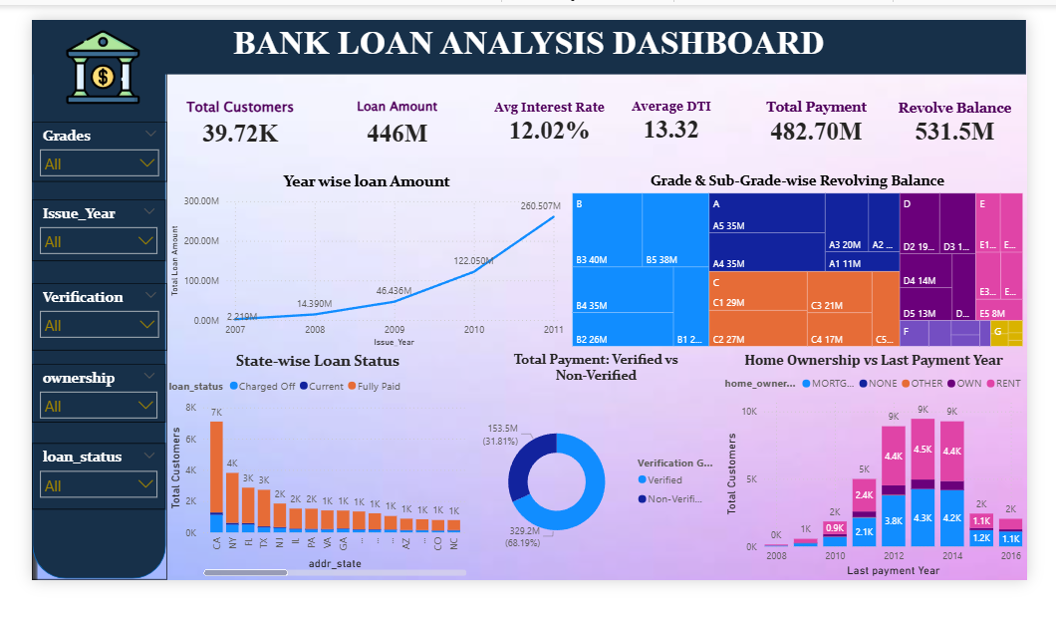
Power bi Dashboard :

Slide 12
Key Insights
Loan amount increased from $2M (2007) to $261M (2011).
Grade B recorded the highest revolving balance, with B3 and B5 ≈ $40M each.
Verified borrowers recorded the highest total payments at $220M.
California, New York, Texas, and Florida showed high loan activity.
Mortgage and Rent categories recorded the highest payment amounts.

Slide 13
Recommendations :
Enforce Income Verification: Require mandatory income proof for high-value loans, as verified borrowers drive over 68% of reliable loan repayments.
Expand in Low-Risk Tiers: Focus marketing and lending efforts on Grade A and Grade B applicants to maintain low default rates while expanding the portfolio.
Focus on Key Regions: Allocate dedicated risk and growth capital to high-volume states like California, Texas, New York, and Florida.
Target Homeowners & Renters: Offer competitive interest rates

Slide 14
Future Scope :
Automate data refresh and reporting.
Build real-time loan monitoring dashboards.
Add predictive analysis for loan default risk.
Analyze customer segmentation.
Develop early-warning indicators for repayment issues.
Integrate additional banking/customer datasets.

Slide 15
Conclusion :
In conclusion, by using end-to-end data analytics across SQL, Excel, Tableau, and Power BI, this project proves how smart data decisions can turn raw banking records into clear business insights, helping us safely grow our loan portfolio while keeping credit risk fully under control.

Slide 16
THANK YOU
✿✿✿✿✿✿✿✿

